Slide 1
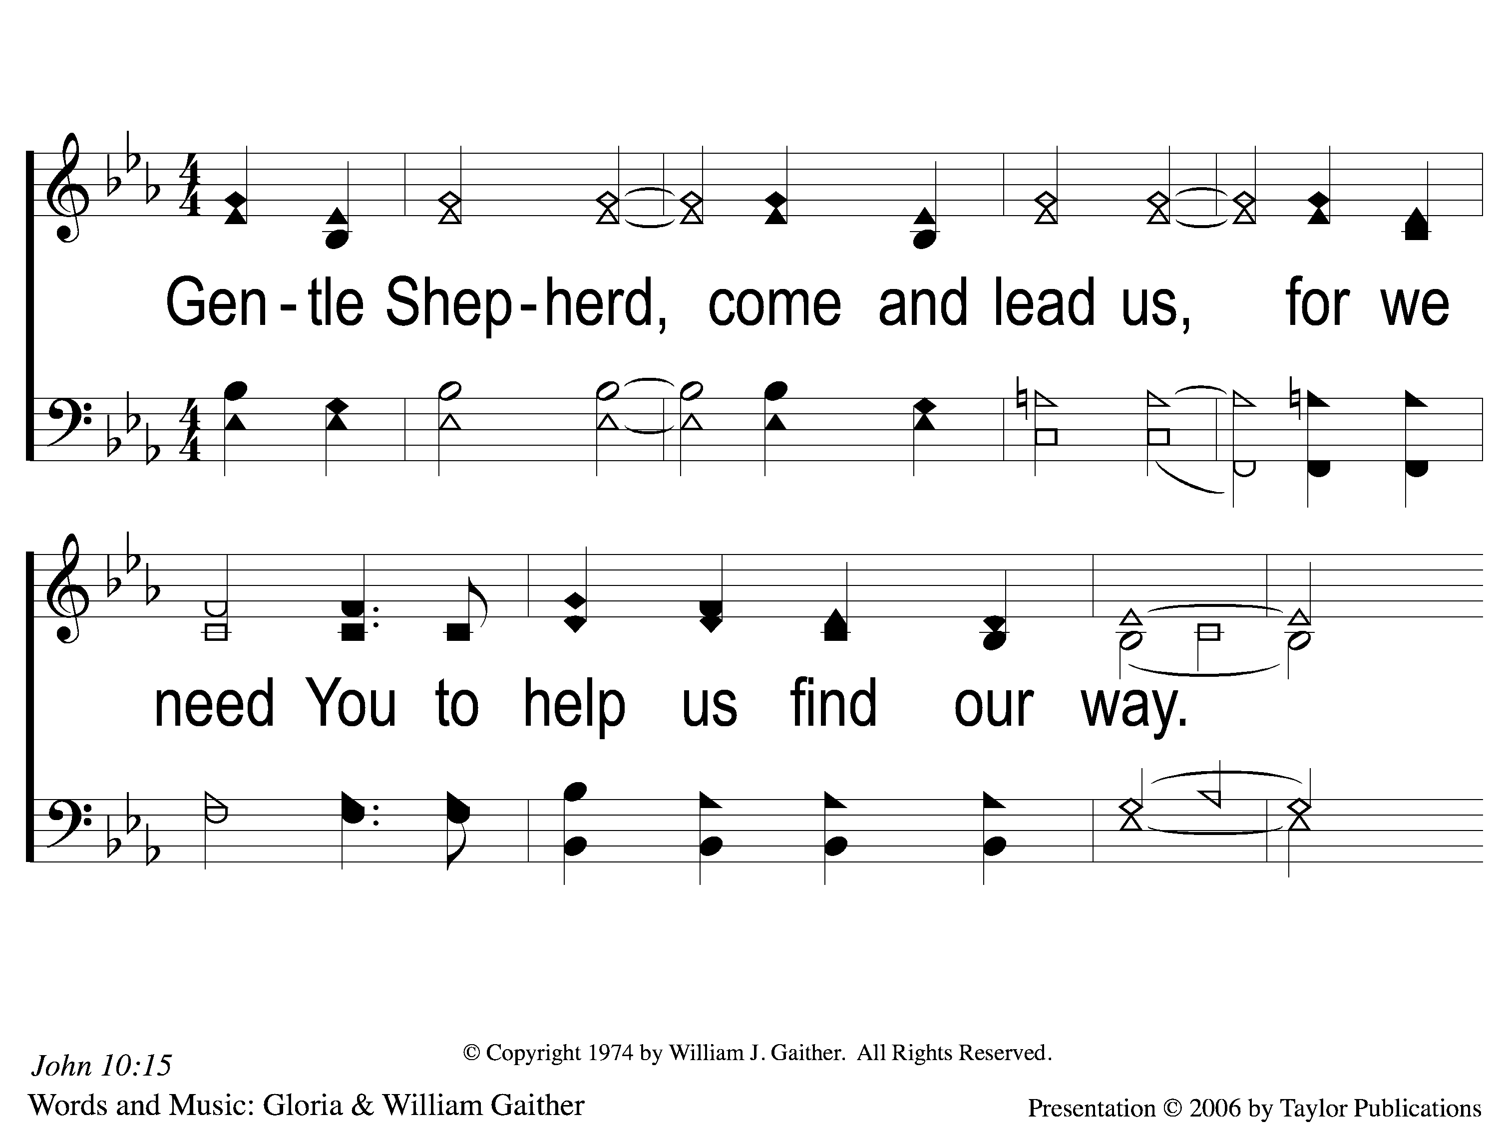
1 Gentle Shepherd
Gentle Shepherd
845

Slide 2
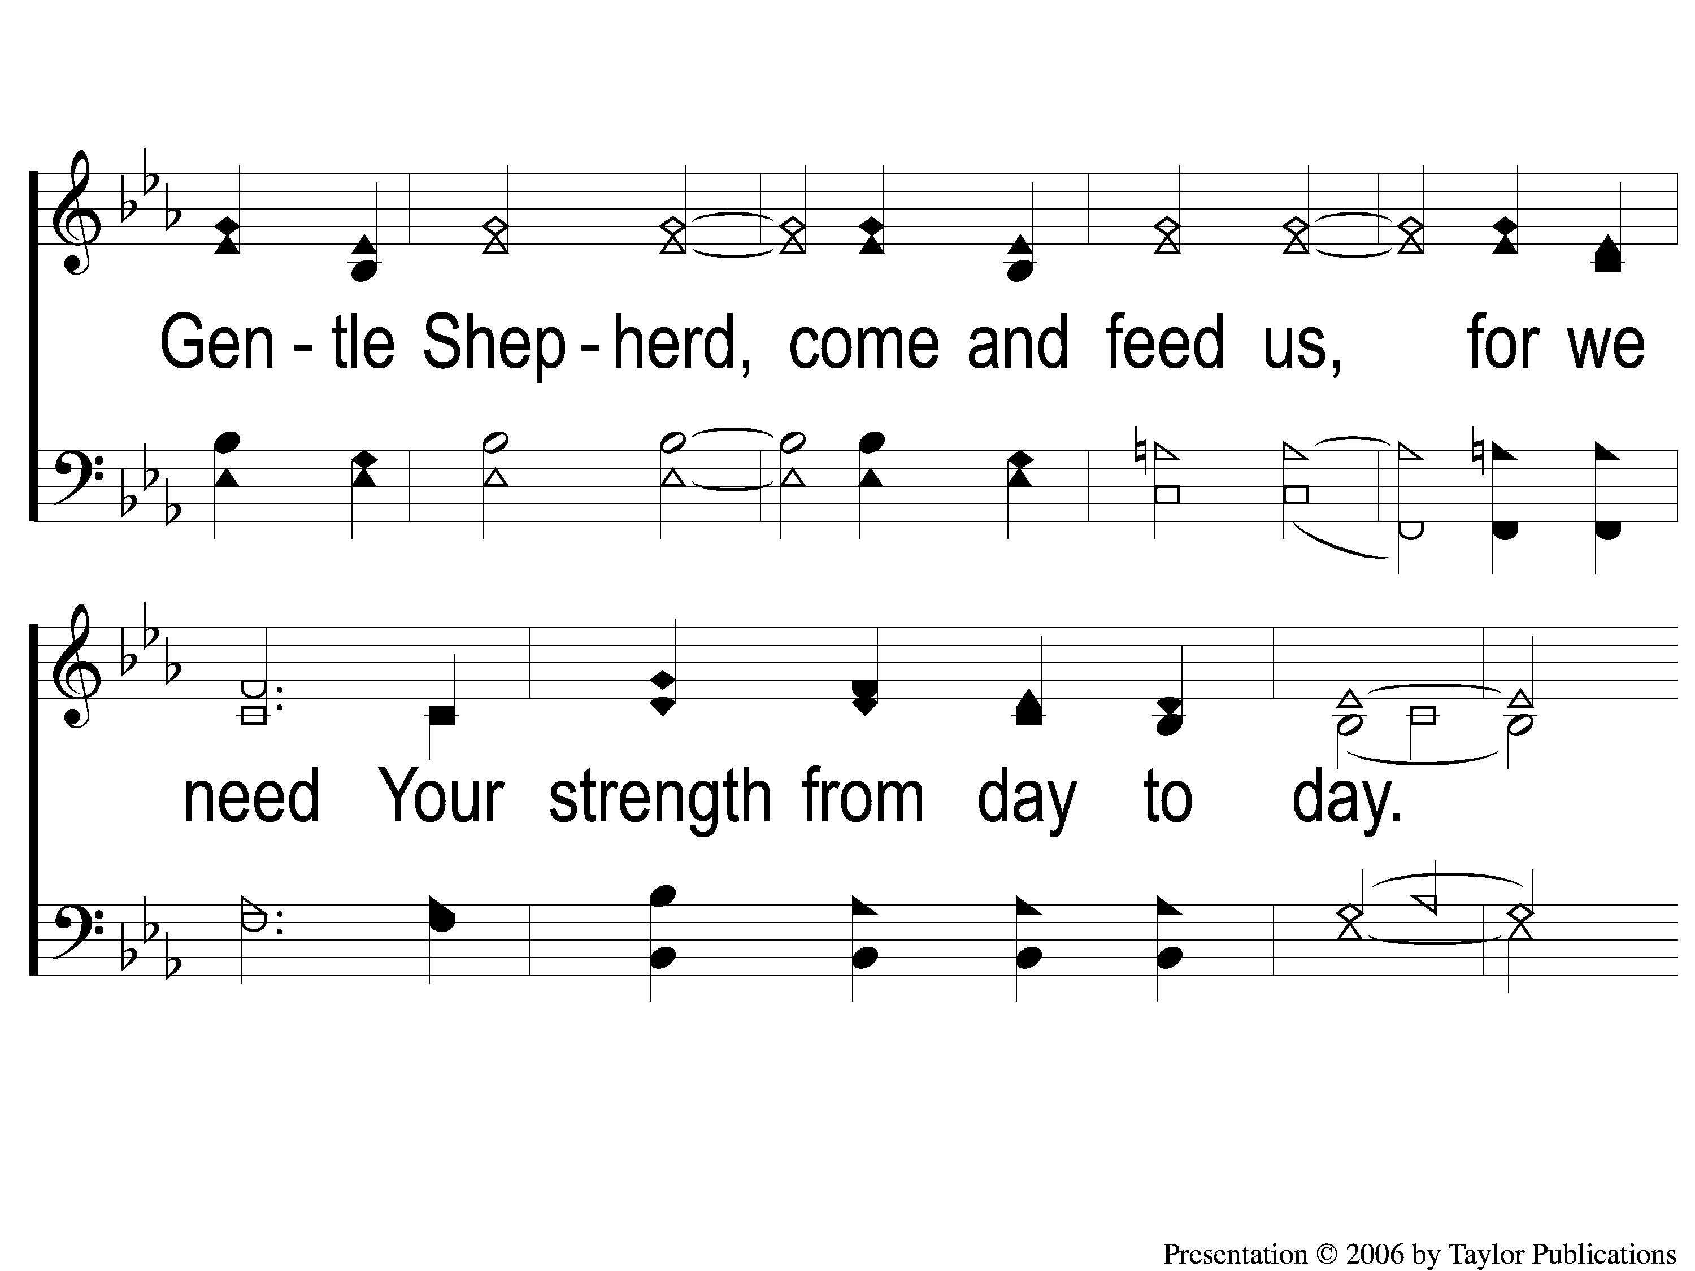
2 Gentle Shepherd
Gentle Shepherd
845

Slide 3
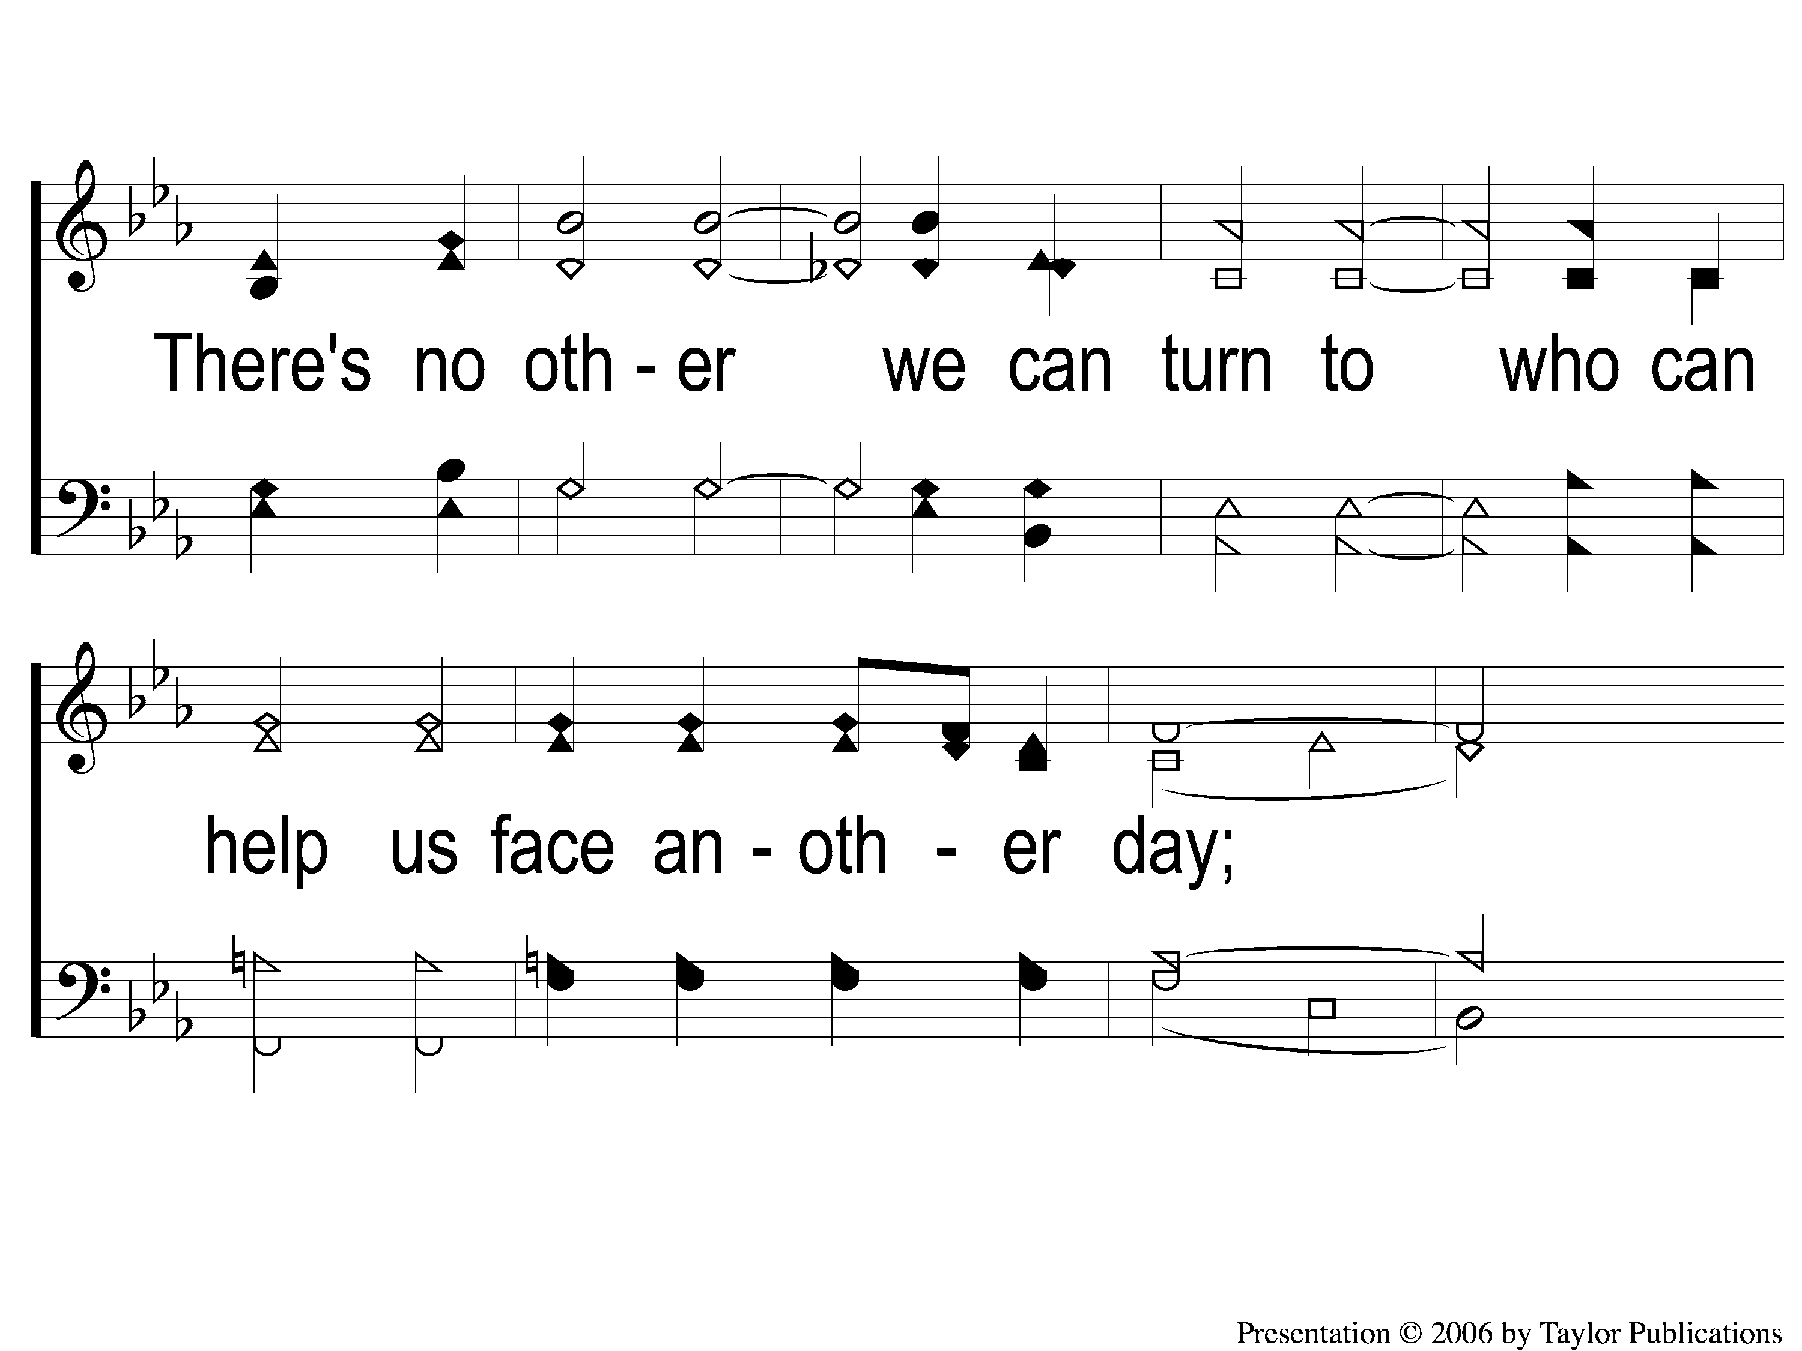
3 Gentle Shepherd
Gentle Shepherd
845

Slide 4
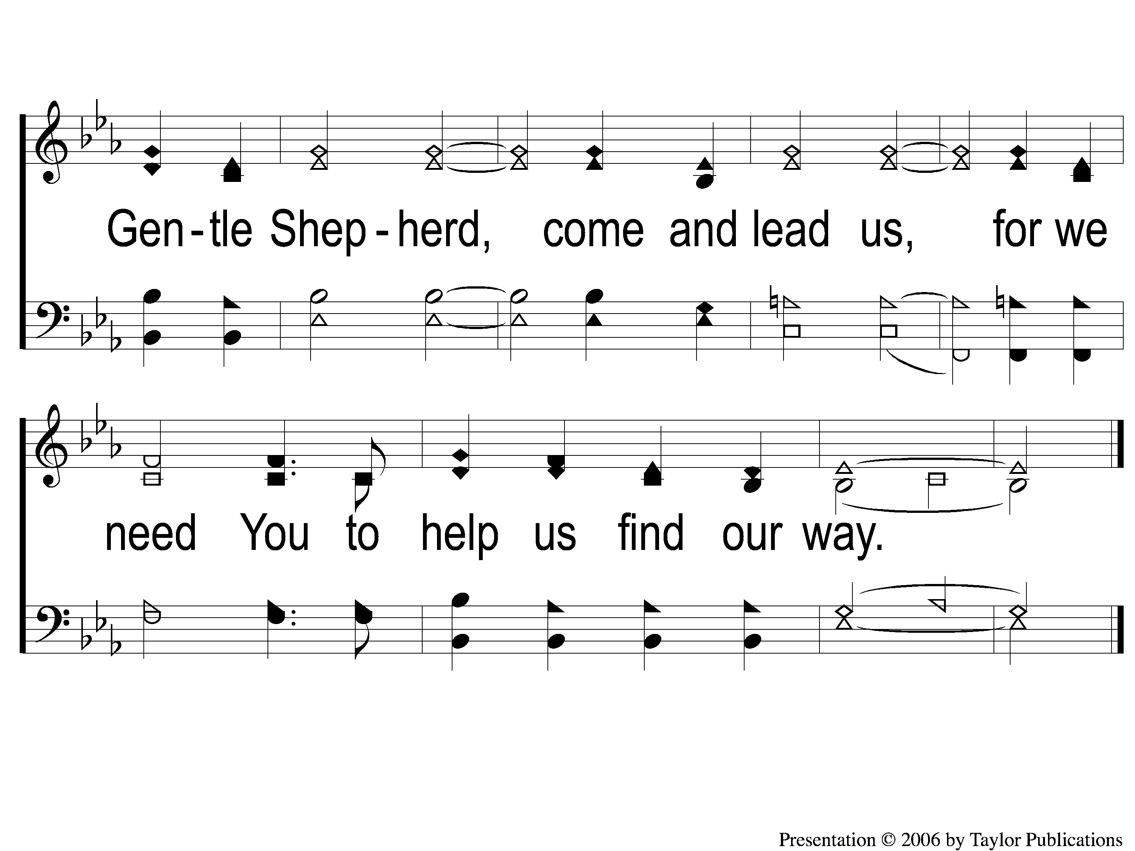
4 Gentle Shepherd
Gentle Shepherd
845

